Slide 1

AIESEC : Matchability (step 1)
June 21th, 2019
Notes:
Good afternoon everyone, thank you for having us!
So its been around 2 weeks since we last met.
Ending our last meeting, we had defined what the main objectives for today were and what we were going to be working on up till now, which overall regarded exploring the AISEC database, understanding how the first steps of the matchability algorithm would work and how we would go about getting setup for further iterations.
So let’s dive into it right now.

Slide 2
Overview
Data Cleaning
On average, 0.03% of date fields on each columns were badly formatted.
Frequent use of mixed null data types: floats, numpy.nan, strings, etc.
Other.
Data Manipulations
Merging of opportunities and applications in preparation for model training.
Computing the opportunity acceptance rate per country and visualizing it.
Data Analysis
Interpreting the acceptance rate world map.
Descriptive analysis of the data based on acceptance rate per region and country.
Relating correlated proxy variables (HDI, GDP per capita)
Notes:
So the plan is the following: we’ll briefly skim over the main data cleaning procedures that were necessary to start analyzing the data before jumping into the core manipulations that were carried out and then finally look at the descriptive analysis of the results produced.
So quickly hitting those bullet points, in terms of cleaning we tackled the following… (on slide)
For the manipulations, (on slide)
And lastly, but most importantly, (on slide)

Slide 3
Data Cleaning
What was cleaned, why?
Data Cleaning
Openings
Dates
NaN types
Threshold handling opportunities with absurd amounts of openings.
Mainly coming from: Egypt, Brazil, Iran and some others.
Mainly years value in date fields found to be inconsistently written.
Affected ability to select rows properly by their datetimes.
Null/NaN types found to have variable types in the table.
Error checking, null evaluations and value replacements made more difficult.
Notes:
Very briefly, the data cleaning was focused on three main aspects: filtering absurd opening numbers, formatting date fields, and evaluating inconsistent null types in the database.
Overall, these were standard procedures so won’t spend too much time on this… Although it would be nice if your web developers took a little more time and energy to validate and format the data inputs ;)

Slide 4
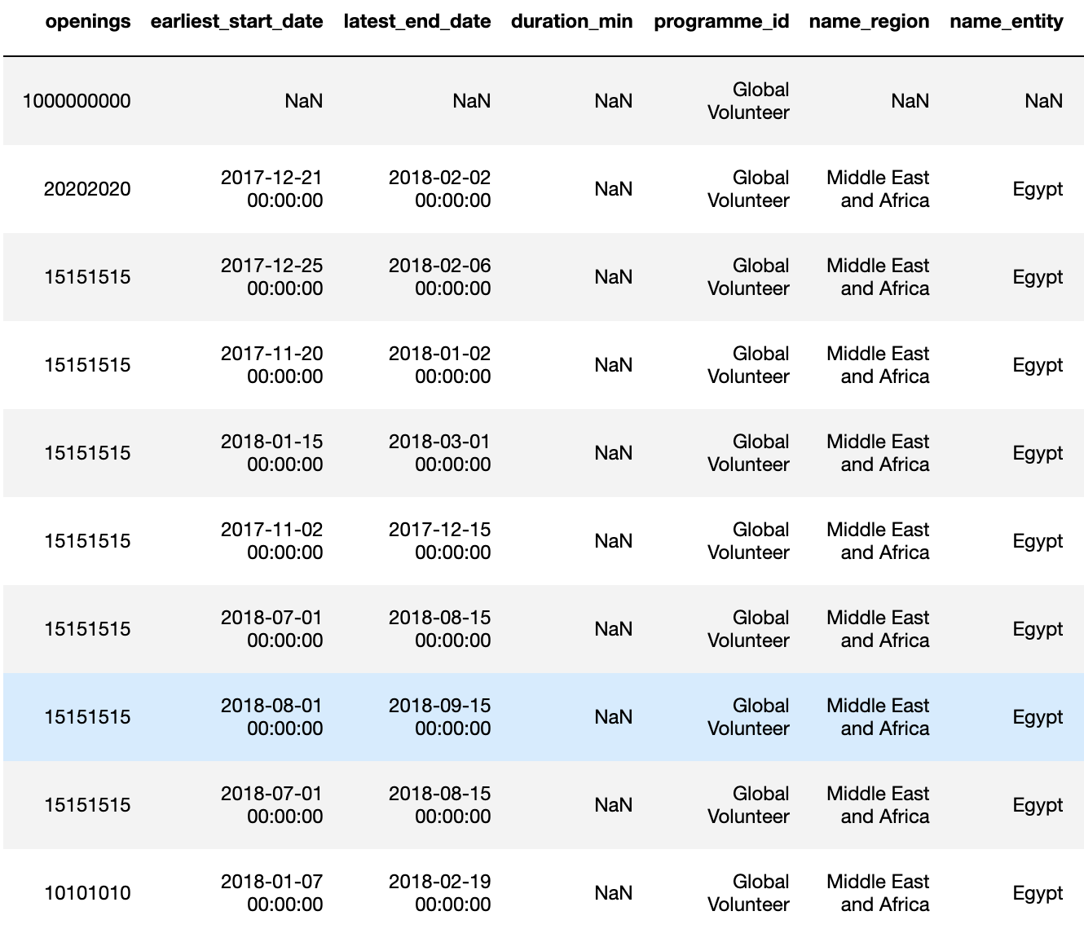
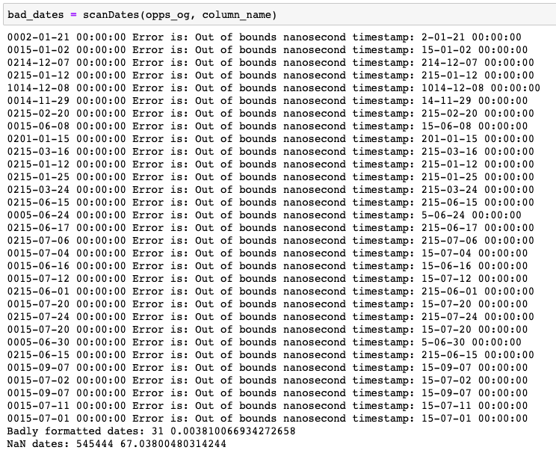

Data Cleaning (contd.)
What was cleaned, why?
Notes:
So just to top off this discussion about data cleaning, which is far too captivating ;) … here are some examples of cleaning required for the number of openings and for the date formats...
Any questions?

Slide 5
Data Manipulation
What operations were done on the data?
Opportunities
Merged
Applications
Data Manipulations
Newly created variables of interest:
application_open_window, experience_max_duration, created_vs_earliest_start, created_vs_latest_end, experience_timeframe_rigidness, hot_days_intersection, popular_time_period_factor
Notes:
Alright so moving down to the core data manipulations. The idea, as part of the main objective for today’s meeting regarding the exploration and descriptive analysis of the database in preparation for the matchability algorithm, was to merge the opportunities and the applications tables into one and to extrapolate additional variables which would be of strong interest.
In other words, for each opportunity, we stored the number of accepted applicants, the basic opportunity description and derived other variables which I’ll present to you in just a second.
This merge was very useful to represent the acceptance rate of experiences around the world relative to the region. We’ll come back to this shortly.

Slide 6
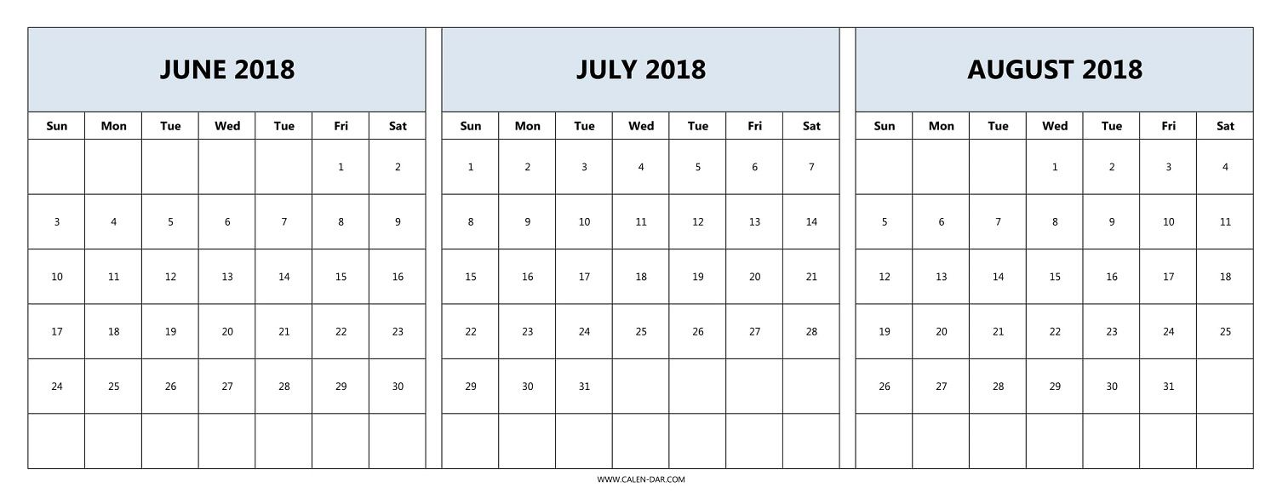
Data Manipulation
New variables of interest.
created_vs_earliest_start
experience_max_duration
created_at
application_close_date
earliest_start_date
experience_start_date
experience_end_date
latest_end_date
duration_min
created_vs_latest_end
application_open_window
experience_max_duration
experience_timeframe_rigidness
=
duration_min
hot_days_intersection
Notes:
So visually here we interpret the meaning of the newly created variables.
Two interesting new variables, although mathematically relatively simple to obtain, are the experience_timeframe_rigidness and the hot_days_intersection.
The first describes how restricted the timeframe of the experience is, by comparing what the ratio between the maximum duration and the actual duration. For example, an internship starting on the 1st of June and ending on the 30th of June having a duration of 4 weeks is far more ”rigid” than one lasting 1 week for the same timeframe. This will come in handy later on.
Then, the hot_days_intersection basically assumes, with strong confidence that the months of July and August are very popular periods which students target giving these periods importance. Therefore, we simply calculate the number of days of an experience that intersect this period to rank the expected popularity of a similar experiences with different start and end dates.

Slide 7
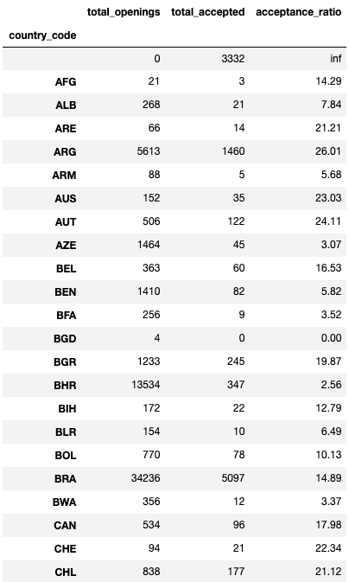
Data Manipulation (contd.)
What was done with the data?
Merged
…
Notes:
Finally, by combining the merged table and the newly created variables, we come up with an acceptance rate based on the country emitting the opportunity.
As this is pretty self-explanatory, we’ll jump to the visual representation of these results on a nice world map right away.
Any questions?

Slide 8
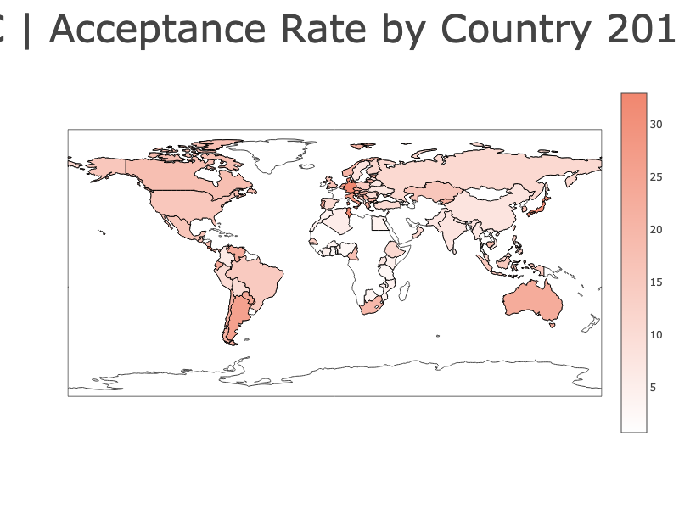

Data Analysis
How did we analyze the “attractivity” of an opportunity?
Acceptance Rate by Country | 2014 - 2018
external link
Notes:
Now, here’s the acceptance rate, for the years 2014 to 2018. (pause)
We can open this locally on the browser also to drag around the map and analyze certain regions more in depth.
Most of the pattern observed are expected and are useful as we will be correlating these geographical acceptance rate patterns with other indicators such as the Human Development Index and the Gross Domestic Product.

Slide 9
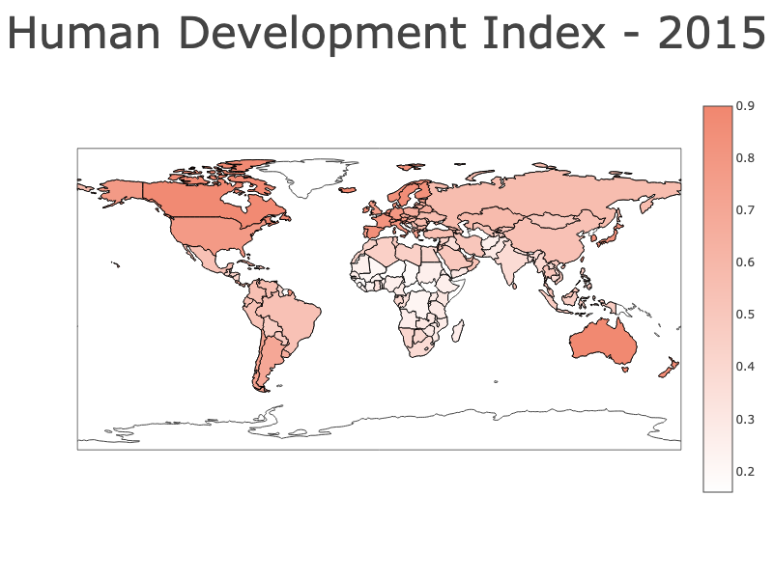
Data Analysis (contd.)
How is the HDI correlated to the acceptance rate of an opportunity?
Human Development Index (including GDP metric factor) | 2015
https://ourworldindata.org/human-development-index#historical-index-of-human-development-hihd-and-gdp
Notes:
So, as mentioned, if we display the Human Development Index including the GDP metric factor from 2015, we observe a strong correlation between the higher acceptance rate regions and the map show here.
In other words, if we put the two maps side-by-side...

Slide 10
Data Analysis (contd)
Comparing the two plots.
Acceptance Rate
HDI
Acceptance rate can be correlated to the HDI (with GDP metric factor).
Notes:
Now, here we clearly see that we can establish a correlation between the acceptance rate of an opportunity in a certain country or region with social and economical indicators such as the Human Development Index and the GDP of a country!
This will form the basis of the model for further steps.
Any questions?

Slide 11
Data Analysis (contd)
Experience description variables to consider.
Experience Description
Level of education
Weekly workload (hours)
Organization type
Language
Start/End date
Number of employees
Salary
Duration (weeks)
Which should we prioritize? What are some other important variables to consider? How to retrieve them?
Notes:
Last point I would like to raise is regarding the different variables listed for an experience/job description.
Here, we listed 7 variables which we though would be appropriate and relevant to study, but we would like your input on this.
Which should we prioritize?
What are some other important variables to consider?
If so, how do should we retrieve them?

Slide 12
Conclusions
Database dates and NaN types problematic, need intensive cleaning.
Cleaning required.
Handling opportunities with absurd openings numbers.
Cleaning required.
Merging of opportunities and applications table.
Preparing data for model training.
Practical and efficient to perform a descriptive analysis of the acceptance rate of an opportunity based on the country emitting it.
Global view of the “attractivity” of opportunities around the world.
Variables to be considered during experience description an analysis.
Notes:
To wrap it up, we looked at these topics today:
(read slide)

Slide 13
Next steps
Consolidate the choice of the variables of interests to be considered in the model.
Experience description variables.
Approve the newly created variables in the “merged” table of opportunities and application.
Question: What is the meaning of the variable close_date? Is it related to the date where an applicant is found?...
Feedback on analysis of acceptance rate with HDI
Reliable correlation. Other proxy variables possible.
Keeping the correlation updated over the years with new HDI data sources.
Notes:
Finally, here’s what we would need to discuss with you today: (read slide)
Thank you for your time!

